Slide 1
Principles Of Big Data Management
Project Presentation
By
Sravan Varma Appana
Sri Vidya Surya Haritha Jyothula
Lakshmi Sai Krishna Ravilla
Sainath Reddy

Slide 2
RDD QUERY 1:
We used RDD to retrieve the output. This query gives the count of tweets grouped by different operating systems like android,windows,ios etc., of various users.
"SELECT user.name,max(user.statuses_count) AS c FROM tweetTable " + "GROUP BY user.name ORDER BY c desc limit 8 “

Slide 3
RDD QUERY 2:
We used RDD to retrieve the output. This query gives the details of the number of friends greater than given amount.
SELECT user.name, max(user.followers_count) AS c FROM tweetTable GROUP BY user.name ORDER BY c DESC limit 8.

Slide 4
DATAFRAME QUERY 3:
We used data frame to retrieve the output. This query is used to count the number of tweets by each user and it will show the count of top 8 users in the descending order.
SELECT * from tweetTable desc limit 8 (API)

Slide 5
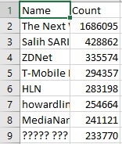
DATAFRAME QUERY 4:
We used data frame to retrieve the output. This query gives the ranking of users based on number of followers in descending order.
SELECT COUNT(*) AS c FROM tweetTable " + "WHERE source LIKE '%Android%'"
SELECT COUNT(*) AS c FROM tweetTable " +"WHERE source LIKE '%iPhone%'"
SELECT COUNT(*) AS c FROM tweetTable " +"WHERE source LIKE '%iPad%'"
SELECT COUNT(*) AS c FROM tweetTable " +"WHERE source LIKE '%Windows%'"
SELECT COUNT(*) AS c FROM tweetTable " +"WHERE source LIKE '%Web Client%'"

Slide 6
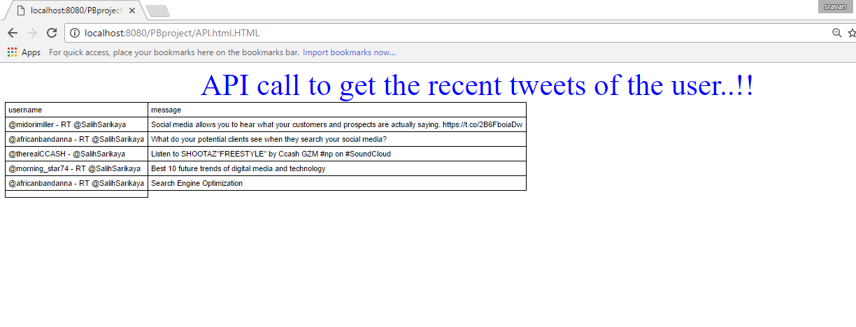
API QUERY 5:
It requires calling public APIs . We take one of the outputs from the above 4 queries and fetch recent tweets by a particular user. The collected data is saved in .txt file.
SELECT user.screen_name, max(user.friends_count) AS c FROM tweetTable " +
"WHERE user.friends_count>'150000'" + "group by user.screen_name order by c desc limit 20;

Slide 7
Video link:
https://youtu.be/tJtAZdWr5ZE

